Slide 1
Learning from the MDGs: Lessons for the SDGs
Special Seminar
on
Moving from MDGs to SDGs:
Bangladesh Experience and Expectation
Organised by
Bangladesh Institute of International and Strategic Studies (BIISS)
Dhaka: 17 September 2015
Presentation by
Professor Mustafizur Rahman
Executive Director, CPD

Slide 2
Learning from the MDGs and Lessons for the SDGs
This presentation draws on four studies carried out under the aegis of Southern Voice on Post-MDG International Development Goals, which is a partnership of 48 Southern Think Tanks, hosted at the CPD
“Attaining the MDGs: How Successful are the LDCs?” http://cpd.org.bd/wp-content/uploads/2013/09/Attaining-the-MDGs-in-LDCs.pdf, “Public Expenditure Trends in Low-Income Countries in the Post-MDG Context”. http://erd-report.com/erd/report_2015/press/Public%20Expenditure%20Trends%20in%20Low-Income%20Countries%20in%20the%20Post-MDG%20Context.pdf
“Measuring for Monitoring: State of SDG Data in Bangladesh”. http://www.post2015datatest.com/
“Delivering on the promise: Ensuring the successful implementation of the post-2015 agenda in Bangladesh” [Ongoing]

Slide 3
Contents
Introduction
Learning from the MDGs
Lessons for the SDGs

Slide 4
Introduction
MDGs have often been criticized for being a top-down development agenda. North-dominated
At the seventieth session of the UN General Assembly to be held on 25-27 September 2015, member states will adopt the Sustainable Development Goals (SDGs). In contrast to the MDGs, SDGs consultation process was more inclusive
The SDGs framework is expected to go far beyond the MDGs
17 Goals with 169 associated Targets will come into effect on 1 January 2016 and will guide the international development agenda over the next 15 years
The member states including Bangladesh will commit to work towards implementing the Agenda within their own countries and at the regional and global levels
In this context, one may look back to the learnings from MDGs experience for the purposes of drawing lessons for the SDGs implementation

Slide 5
Learning from the MDGs
MDGs attainment in Bangladesh has been quite impressive
MDG indicators | Latest status | Target by 2015
1.1a: Proportion of Population below national upper poverty line (2,122 kcal), % | 31.5 (HIES 2010) 24.8 (GED Est. 2015) | 29.0
1.8: Prevalence of underweight children under-5 years of age (6-59 months) | 31.9 (MICS 2012-2013) 32.6 (BDHS 2014) | 33.0
2.1: Net Enrolment Ratio in Primary Education | 97.7 (APSC, DPE 2014) | 100
3.1a: Ratio of girls to boys in primary education (Gender Parity Index = Girls/ Boys) | 1.03 (APSC, DPE 2014) 1.07 (MICS 2012-2013) | 1.00
4.1: Under-Five Mortality Rate | 46 (BDHS 2014) 41 (SVRS 2013) | 48
4.2: Infant Mortality Rate | 38 (BDHS 2014) 31 (SVRS 2013) | 31
4.3: Proportion of One-Year Old Children Immunised against Measles | 81.9 (UESD 2013) 79.9 (BDHS 2014) | 100
5.1: Maternal Mortality Ratio (per 100,000 live births) | 170 (MMEIG 2013) 197 (SVRS 2013) | 143
6.1: HIV Prevalence among Population Aged 15-24 Years | <0.1 (9th SS 2011) | Halting
7.8: Proportion of Population Using an Improved Drinking Water Source | 97.9 (MICS 2012-2013) 97.5 (SVRS 2013) | 100
Source: Bangladesh’s MDG Progress Report 2015

Slide 6
Learning from the MDGs
In a number of areas, further attention will be required
For example -
1.5: Employment to population ratio (15+), %
2.2: Proportion of pupils starting grade 1 who reach grade 5, %
2.3: Literacy rate of 15-24 year-olds, women and men, %
3.2: Share of women in wage employment in the nonagricultural sector, %
4.3: Proportion of 1 year-old children immunized against measles, %
5.1: Maternal Mortality Ratio, (per 100,000 live births)
5.2: Proportion of births attended by skilled health personnel, %
5.3: Contraceptive Prevalence Rate, %
6.9a: Prevalence of TB per 100,000 population
7.1: Proportion of land area covered by forest, % (tree coverage)

Slide 7
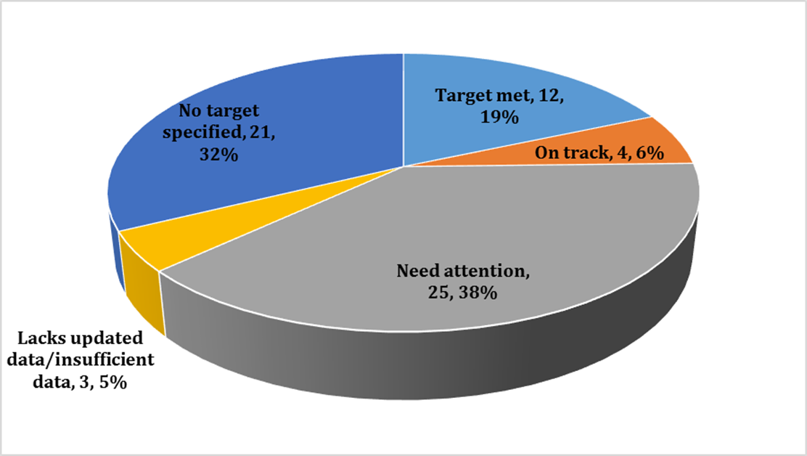
Learning from the MDGs
Achievement of Bangladesh as regards MDGs has been somewhat mixed
Bangladesh’s MDGs Progress Status in terms of 65 Indicators
Source: Bangladesh’s MDG Progress Report 2015 (GED)
To keep in mind: Many of the MDGs Indicators will continue into the SDGs

Slide 8
Learning from the MDGs
After 2000, pace of progress has been uneven across indicators
MDG Performance Estimated by Unbiased Rate of Progress Method (URPM)
MDG indicators | Performance
1.1: Proportion of Population below Poverty Line | Accelerated
1.5: Employment-to-Population Ratio (15+) | Slow Down
1.9: Proportion of Population below Minimum Level of Dietary Energy Consumption | Slow Down
2.1: Net Enrolment Ratio in Primary Education | Accelerated
2.3: Literacy Rate of 15-24 Year Olds, Women and Men | Accelerated
4.1: Under-Five Mortality Rate | Slow Down
4.2: Infant Mortality Rate | Slow Down
4.3: Proportion of One-Year Old Children Immunised against Measles | Accelerated
5.1: Maternal Mortality Ratio | Slow down
6.1: HIV Prevalence among Population Aged 15-24 Years | Maintained
7.1: Proportion of Land Area Covered by Forest | Accelerated
7.8: Proportion of Population Using an Improved Drinking Water Source | Maintained
7.9: Proportion of Population Using an Improved Sanitation Facility | Accelerated

Slide 9
Learning from the MDGs
MDG progress has also been uneven across different regions within Bangladesh
Divisions | 1.1: Proportion of Population below Poverty Line (%) | 1.8: Prevalence of underweight children under-5 years of age (%) | 4.1: Under-5 Mortality Rate (per 1000 live births) | 4.2: Infant Mortality Rate (per 1000 live births) | 5.1: Maternal Mortality Ratio (per 100,000 live births)
National | 31.5 | 32.6 | 41.0 | 31.0 | 197.0
Barisal | 39.4 | 36.9 | 43.0 | 28.0 | 234.0
Chittagong | 26.2 | 36.0 | 39.0 | 30.0 | 196.0
Dhaka | 30.5 | 28.5 | 36.0 | 30.0 | 184.0
Khulna | 32.1 | 25.5 | 51.0 | 42.0 | 195.0
Rajshahi | 29.8 | 32.1 | 46.0 | 33.0 | 290.0
Rangpur | 46.2 | 36.8 | 42.0 | 33.0 | 148.0
Sylhet | 28.1 | 39.8 | 47.0 | 40.0 | 174.0
Source | HIES 2010 | BDHS 2014 | SVRS 2013 | SVRS 2013 | SVRS 2013
Note: Green shades denote the best performing Division while red shades signify the worst performing Division.

Slide 10
Learning from the MDGs
One can discern an increasing trend in Bangladesh’s policy documents to address areas relevant to MDGs
Bangladesh has traditionally focused on a number of MDG-related areas, even before the inception of MDGs.
Development plans that were formulated before the adoption of the MDGs had already identified and incorporated a number of MDG-relevant areas to be accorded high policy priority in Bangladesh.
Among the nine (major) selected MDG indicators that were selected for a CPD study, Bangladesh gave priority to seven in its pre-MDGs Development Plan, the Fifth Five Year Plan (1997-2002).
For four indicators quantitative targets were set.
However, specific targets were not set for three issues (gender disparity in primary and secondary education; prevalence of HIV/AIDS, malaria and tuberculosis; forest coverage).

Slide 11
Learning from the MDGs
The study further found that eight out of the nine identified MDG targets were addressed in Poverty Reduction Strategy Paper (PRSP I, 2005).
However, no specific commitments were made in the strategy for two MDG issues (adult literacy and HIV/ AIDS).
The Sixth Five Year Plan (SFYP) (2011-2015) of Bangladesh was the final national development plan during the MDG period which came to its closure in 2015.
Bangladesh continued to address same number of MDG targets in SFYP as it did for PRSP I.
Bangladesh had set specific target in seven MDG areas. Interestingly, to address the issue of forest coverage, an additional target (increase productive forest coverage by 2%) was adopted in SFYP.
Regrettably, the issue of CO2 emissions was consistently lacking in terms of any specific commitment in the national plans of Bangladesh.

Slide 12
Learning from the MDGs
MDG related targets were also considered in designing the major public sector programmes
In post-2000 period, some of the major programmes and policy initiatives had focused on MDGs:
Primary Education Development Programme (PEDP II in 2004-09 and PEDP III in 2011-16);
Education Policy 2010;
The Education Assistance Trust Act 2012;
National Policy for Women’s Advancement (2011);
Health, Population and Nutrition Sector Programme (HPNSP 2003-2011);
Health, Nutrition and Population Sector Development Program (HNPSDP 2011-2016);
National Sustainable Development Strategy (NSDS 2011-2021).

Slide 13
Learning from the MDGs
Resource allocation in Bangladesh has been largely MDG sensitive in the areas of health, social protection and environment
The pace of growth in public health expenditure consistently increased between various inter-temporal periods since 2000.
1.4% in 1996-2000 period; 5.6% in 2001-2005 period; and 12% 2006-2012 period.
This trend, however, did not continue in recent years
Bangladesh has increased its social protection spending both as a share of total budget (by 3.7%) and GDP (by 0.5%) in 2001-2012 period compared to 1991-2000 period.
Growth momentum also accelerated as regards public spending on environment protection in post-2000 period in Bangladesh.
From 0.1% in 1996-2000 period to 4.7% in 2006-2010 period.

Slide 14
Learning from the MDGs
Resource allocation was off –track particularly in the area of education while net ODA inflow declined!
Momentum of growth as regards public spending on education decelerated in post-2000 period in Bangladesh.
From 13.7% in 1991-2000 period to 7.8% in 2001-2010 period. (11.4% in 2011 – 2014 period according to MoF)
The amount of net ODA received (in nominal terms) slightly decreased in the post-2000 period.
Average net ODA received in 1991-2000 period was USD 1,390 million which reduced to USD 1,353 million in 2001-2010 period. (average USD 1,651 million in FY2011-FY2015 according to ERD)
Utilisation capacity of ODA remained a concern!

Slide 15
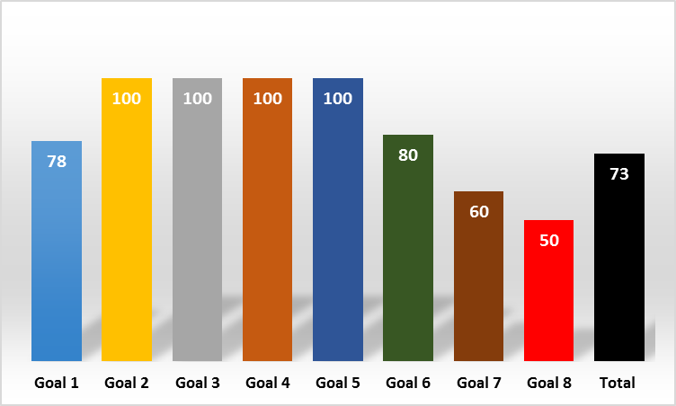
Learning from the MDGs
Data availability (% of total) across MDG indicators
Monitoring progress as regards MDGs was constrained by inadequate data and information
Out of total 60 indicators under the 8 goals and 21 targets, data was available for 44 indicators (73% of total).
Partially available data (for which data may not be available at disaggregate level or is not updated regularly) are also considered to be available in this context.
Availability of data was found to be quite good (80% indicators) for MDG 1 (Eradicate extreme poverty and hunger) and MDG 6 (Combat HIV/AIDS, malaria and other diseases).
On the other hand, data availability situation for MDG 7 (Ensure Environmental Sustainability) and MDG 8 (Develop a Global Partnership for Development) was not satisfactory.

Slide 16
Learning from the MDGs
Experience as regards MDG related data also indicates:
Lack of data did not allow setting up reference year indicators for a number of MDGs.
Inadequacy and paucity of data did not allow real time measurement of progress with respect to a number of MDG targets and indicators.
A number of MDG indicators did not have quantifiable targets in absence of the required data.
It was often difficult to access data due to different administrative bottlenecks.
The status of electronic dissemination of data was also rather poor.

Slide 17
Learning from the MDGs
Monitoring and evaluation was one of the weakest areas of MDGs, both at country and global levels
Weak monitoring and accountability practice
Silo approach in implementation
Inadequate data availability
Low level of engagement with stakeholders

Slide 18
Lessons for the SDGs
It is critically important to keep the key elements of SDGs in perspective
The synthesis report of the Secretary General on the post-2015 agenda, “The road to dignity: ending poverty, transforming all lives and protecting the planet” was published in December 2014. The report presents six elements for delivering on the SDGs which “… would help frame and reinforce the universal, integrated and transformative nature of a sustainable development agenda …”. The six elements are:
Dignity: to end poverty and fight inequalities
People: to ensure healthy lives, knowledge, and the inclusion of women and children
Prosperity: to grow a strong, inclusive, and transformative economy
Planet: to protect our ecosystems for all societies and our children
Justice: to promote safe and peaceful societies, and strong institutions
Partnership: to catalyse global solidarity for sustainable development

Slide 19
Lessons for the SDGs
Goal 1. End poverty in all its forms everywhere
Goal 2. End hunger, achieve food security and improved nutrition and promote sustainable agriculture
Goal 3. Ensure healthy lives and promote well-being for all at all ages
Goal 4. Ensure inclusive and equitable quality education and promote lifelong learning opportunities for all
Goal 5. Achieve gender equality and empower all women and girls
Goal 6. Ensure availability and sustainable management of water and sanitation for all
Goal 7. Ensure access to affordable, reliable, sustainable and modern energy for all
Goal 8. Promote sustained, inclusive and sustainable economic growth, full and productive employment and decent work for all
Goal 9. Build resilient infrastructure, promote inclusive and sustainable industrialization and foster innovation

Slide 20
Lessons for the SDGs
Goal 10. Reduce inequality within and among countries
Goal 11. Make cities and human settlements inclusive, safe, resilient and sustainable
Goal 12. Ensure sustainable consumption and production patterns
Goal 13. Take urgent action to combat climate change and its impacts
Goal 14. Conserve and sustainably use the oceans, seas and marine resources for sustainable development
Goal 15. Protect, restore and promote sustainable use of terrestrial ecosystems, sustainably manage forests, combat desertification, and halt and reverse land degradation and halt biodiversity loss
Goal 16. Promote peaceful and inclusive societies for sustainable development, provide access to justice for all and build effective, accountable and inclusive institutions at all levels
Goal 17. Strengthen the means of implementation and revitalize the global partnership for sustainable development

Slide 21
Lessons for the SDGs
The Agenda: Inclusive, transformative, integrated and universal
How the ‘universal’ SDG will be rearticulated at the national level reflecting the contextual priorities?- Still an issue of debate
Country-led implementation
A revitalised Global Partnership: An area much criticized during MDG implementation
Follow-up and review processes will be voluntary and will respect policy space and priorities of the countries
Global review will primarily be based on national official data sources – country reports and thematic reports
Data Revolution
Separate Goal (17) for means of implementation (MoI) and MoI targets under each Goal

Slide 22
Lessons for the SDGs
New areas of SDGs (e.g. cities and human settlements, ecosystem and biodiversity) will call for greater effort and resources at the country level
Much more ambition and effort is required on the part of the national, regional and international community.
It is important to sensitise national policies in line with SDGs!
An important issue with respect to SDGs is how their implementation will be financed.
Public finance (domestic resource mobilization) and foreign aid are expected to continue to be central to supporting the implementation of the SDGs, but they will not be adequate.
Other potential sources of financing include:
resources generated from the private sector (including remittances)
crackdown on illicit financial flows and corruption
trade and market access
foreign direct investment

Slide 23
Lessons for the SDGs
Concerns have been raised about the sheer breadth and ambition of these goals, the feasibility of monitoring them and tracking actual progress within countries.
If monitoring of 8 MDGs, 20 targets and 60 indicators have posed serious challenges at the national level, how about 17 SDGs, 169 targets and over 300 indicators?
Capacity of national statistics office and other government agencies will be tested
Accessibility, quality and timeliness of data will be critical. To fix a reference year will be a challenge: 2010?; 2015?
Rapid technological progress should be put into effective use
Attainment of SDGs will require a strong and effective institutional mechanism involving all stakeholders including public representatives (central and local), government (executive & bureaucracy), private sector, civil society, knowledge community, and development partners.

Slide 24
Thank You

